Slide 1


Online Course Recommendation P530

Slide 2


Team Members
Keerthi Mani Purna Chandrika
ASWANTH TK
Jithin K S
Sonam Akshay Sherkar
Saurabh Sanjay Lonari
Sanket Rajendra Ghadge

Slide 3
Introduction
This project focuses on developing an online course recommendation system that suggests personalized courses to users based on their interaction history and course features. By leveraging recommendation models, the goal is to enhance user experience, improve engagement, and help learners discover relevant content efficiently.

Slide 4
INSTALLING NECESSARY PACKAGES AND LIBRARIES
pandas For data manipulation and analysis (loading, filtering, grouping, etc.)
numpy For numerical operations and statistical computations
matplotlib.pyplot For creating basic visualizations (bar charts, histograms, etc.)
seaborn For advanced, beautiful visualizations (box plots, heatmaps, etc.)
Installed openpyxl to work with Excel files using pandas.read_excel()

Slide 5
Data Quality & Summary
• ✅ No missing values in the dataset
• ✅ No duplicate rows found
• 👤 43,242 unique users out of 100,000 total records
• 📚 20 unique courses offered
• 🧑‍🏫 20 unique instructors
• 📜 Certifications and study materials: provided for some courses, not all

Slide 6
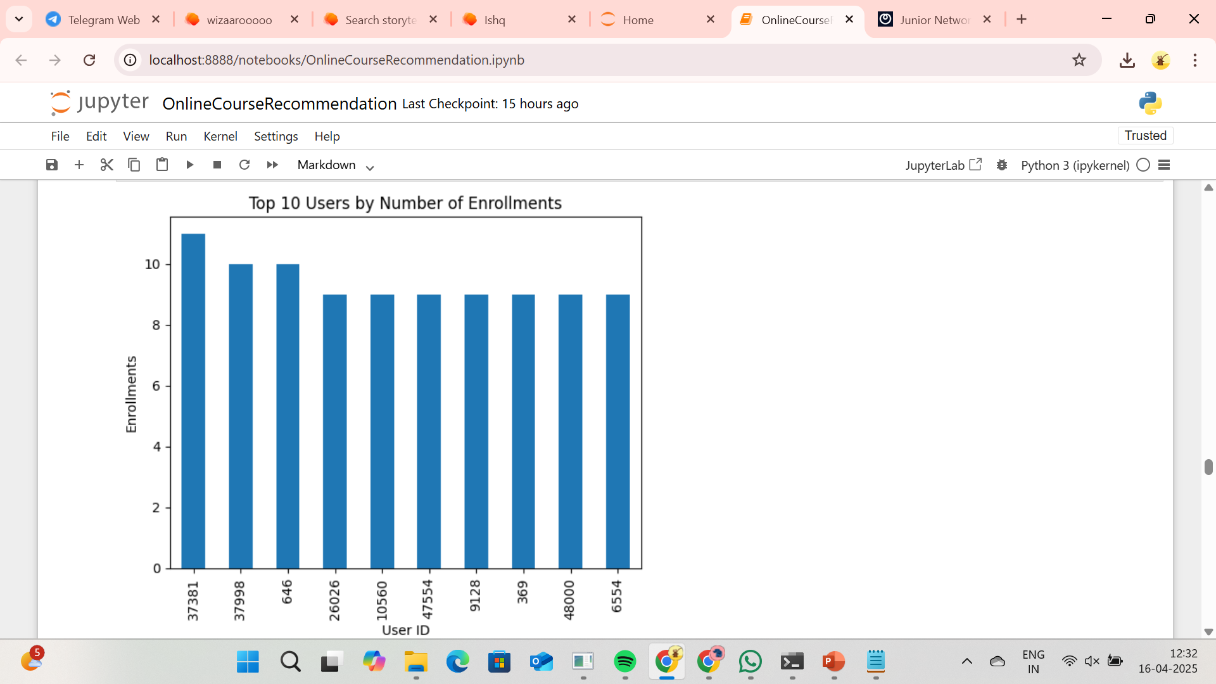
Visualizations

Slide 7
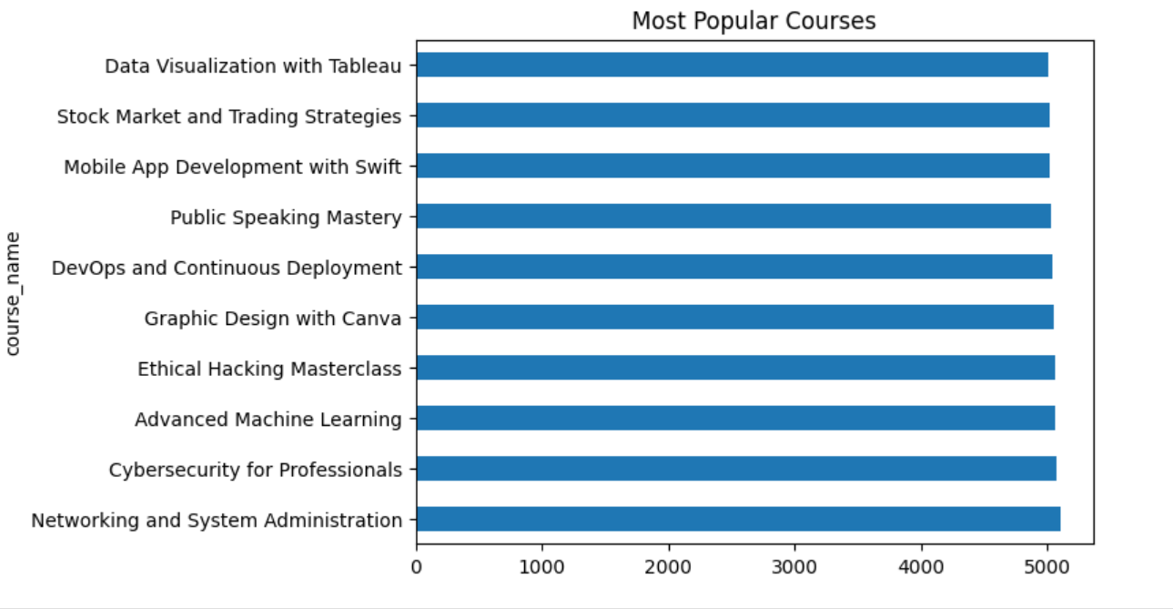
Visualizations

Slide 8
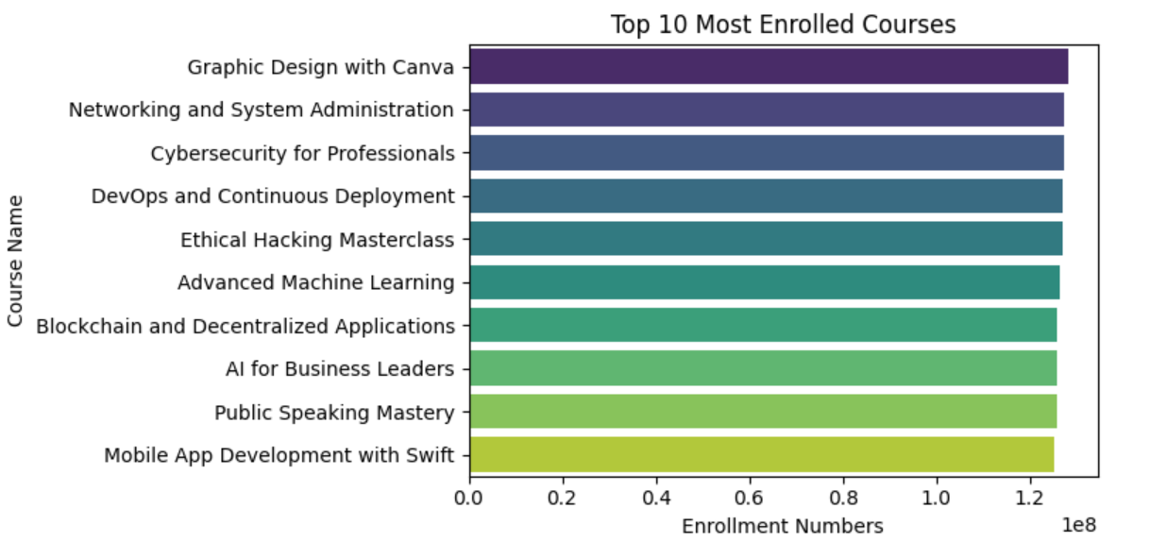
Visualizations

Slide 9
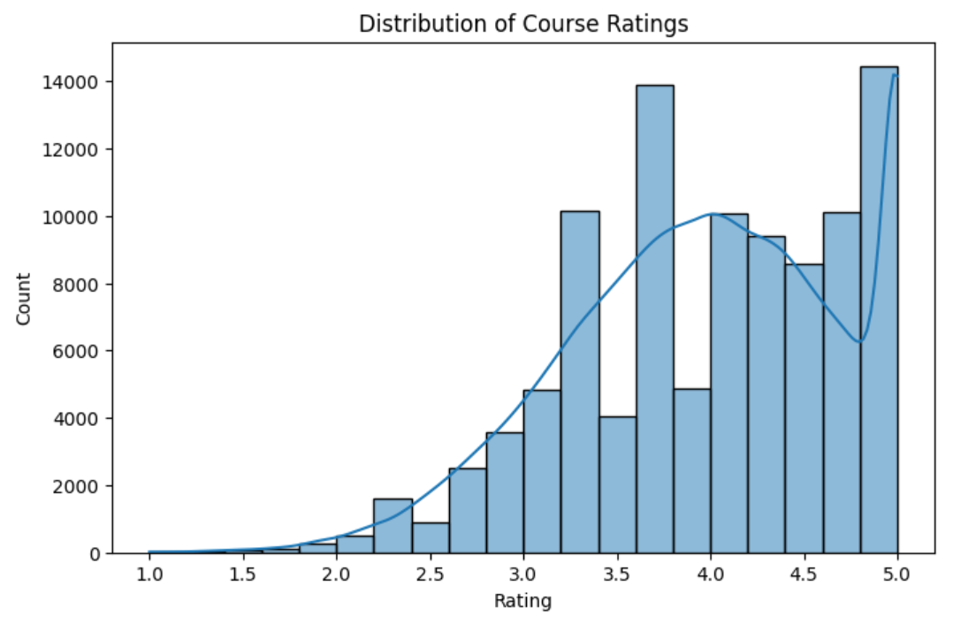
Visualizations

Slide 10
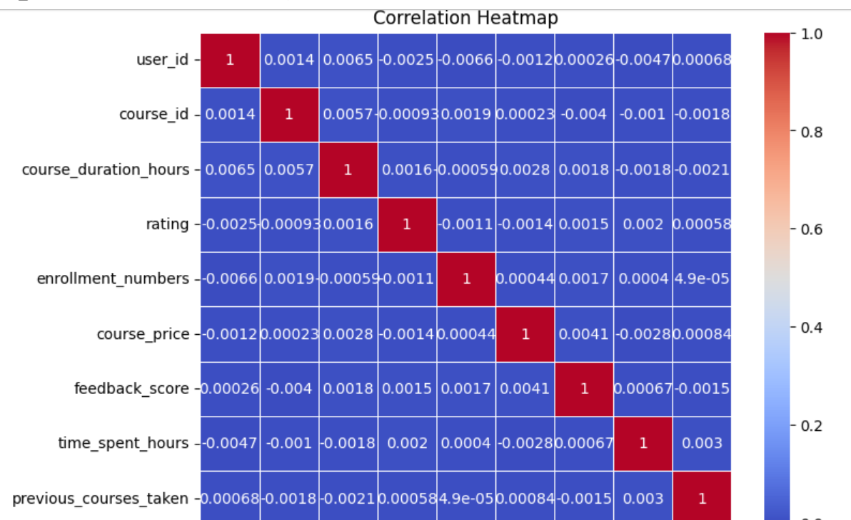
Visualizations

Slide 11
User-Course Matrix Analysis
📊 Constructed a User-Course interaction matrix
🧮 Sparsity of the matrix: 99.98%
🔍 Indicates very few users have interacted with most courses
💡 Common scenario in recommendation systems (cold start problem)

Slide 12
Model Building

Slide 13
Data Preprocessing
Encodes categorical features (course_name,instructor,difficulty_level,study_material_available) using LabelEncoder.
Normalize numeric features like course duration,price,rating and engagement metrics using MinMaxScaler.

Slide 14
Popularity-Based Recommendation
Simple approach to recommend couses based on highest enrollment numbers.
Returns top N popular courses sorted by enrollment_numbers.

Slide 15
Content-Based Filtering
Uses three fetures (enrollment_numbers,previous_courses_taken,time_spent_hours) to create a user profile vector.
Scales these features for the input and the dataset.
Calculates cosine similarity between the user profile and courses to find the most similar courses.
Returns the top N courses most similar to the input profile.

Slide 16
Collaborative Filtering
Recommends courses based on preferences of similar users.
Needs enough user-item interaction data.
Struggles with cold-start problems for new users or items.

Slide 17
KNN Recommendation
Finds similar users (user-based) or similar items(item-based) using distance/similarity measures.
Simpler alternative to matrix factorization.
Requires computation of distances between feature vectors.

Slide 18
Utility-Based Recommendation
Makes recommendations based on calculated utility scores per user.
Utility can combine various inputs(ratings,engagements,preferences).
Focused on maximizing user satisfaction.

Slide 19
Knowledge-Based Recommendation
Recommends courses using explicit knowledge about user preferences and course attributes.
Works wll when historical data is insufficient.
Often rule-based or uses contraints set by users.(e.g ‘Only certified under 2 hours’.)

Slide 20
Hybrid Recommendation
Combines two or more recommendation strategies (e.g content + Collaborative).
Improves accuracy and robustness.
Reduces individual model limitations.(e.g cold start or sparsity).

Slide 21
Evaluation Matrix
Accuracy Score:Measures the percentage of correct predictions in classification task.
Precision,Recall,F1-score:Used to evaluate multi-class classification performance.

Slide 22
Usage
Popularity-Based:Display top N highest-rated or most-enrolled courses.
Content-Based:Given a course index,returns the top N similar courses.
Collaborative Filtering: Given a user ID ,recommends top N courses based on similar user ratings.
KNN: Finds nearest neighbors (users or items) based on feature similarity for recommendation.

Slide 23
Usage
Hybrid:Combines outputs (e.g averages or blends content and collaborative results) for more accurate recommendations.

Slide 24
Model Deployment
Framework:Uses Streamlit for building an interactive web app.
Data Loading: Loads course data from an Excel file.
User Input: Collects user preferences(enrollment,interest,engagement) via sliders in the sidebar.
Data Preprocessing: Label encoding for categorical fields.MinMax scaling for numerical fields.

Slide 25
Model Deployment
Recommendation Logic:
Popularity-based:Recommends top courses based on enrollment numbers.
Content-based:Uses cosine similarity between user input and scaled course features to recommend similar courses.

Slide 26
Model Deployment
Output:
Shows dataset preview and stats.
Displays personalized and popular course recommendation.
Modular Functions: Cleanly separated functions for diaplaying recommendations,course details, and footer.

Slide 27
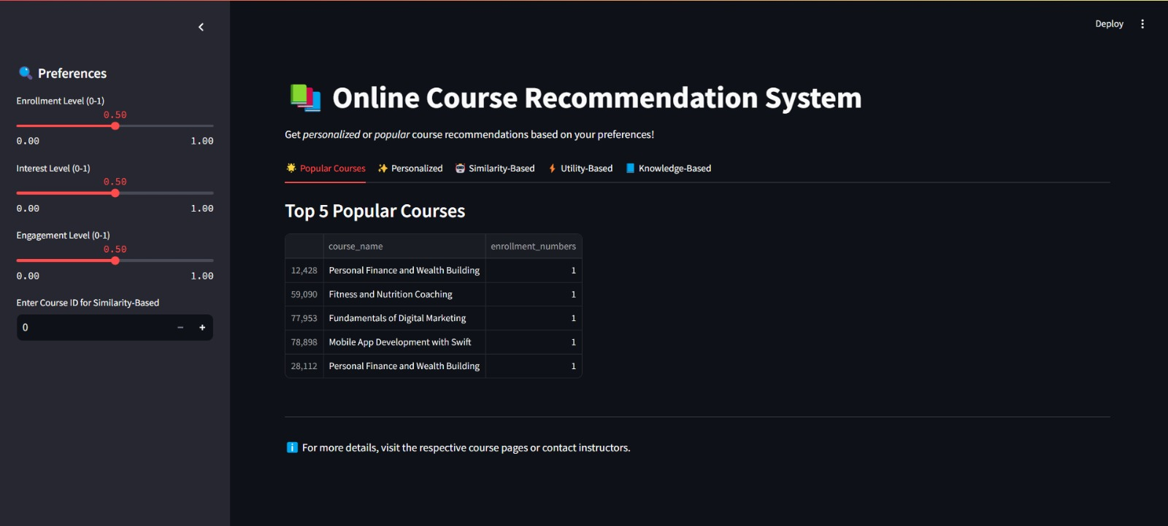
UI of Online Course Recommendation System

Slide 28
Challenges
Feature Selection:The similarity models only use a few scaled numeric features (enrollment_numbers, previous_courses_taken, time_spent_hours).
Memory Load:Using cosine_similarity over the entire dataset or fitting KNN on all features can become memory-heavy if the dataset grows large.
Sparse Data:If many users or courses have few interactions, the collaborative filtering (KNN) and similarity computations may become unreliable.

Slide 29
Conclusion
In this project, we built an online course recommendation system using recommendation models to suggest relevant courses to users based on their interactions and preferences. The models performed well after data preprocessing and feature engineering. Despite some challenges like cold-start issues and missing data, the system provides a solid base for personalized course recommendations.

Slide 30
THANK YOU

